Slide 1
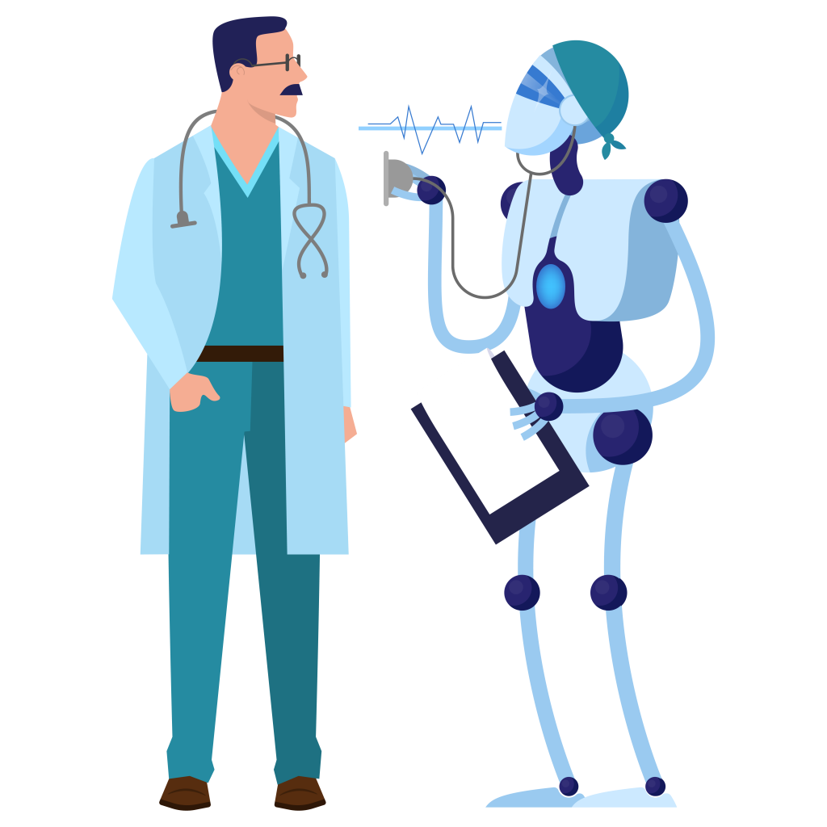
Why AI should not substitute the role of the doctor
Simone Callegarin, Sabrina Azzi, Francesco Tarantino, Stefano Montesi

Slide 2
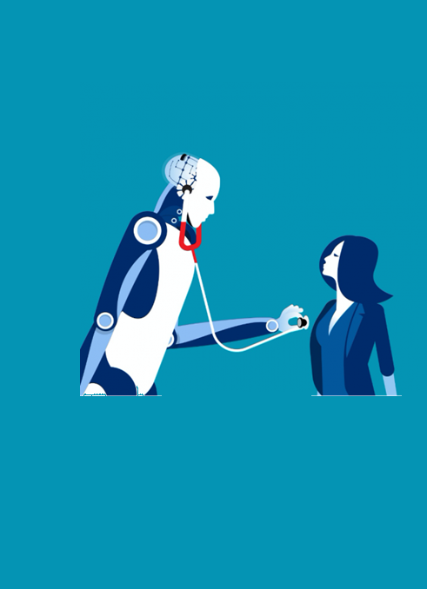
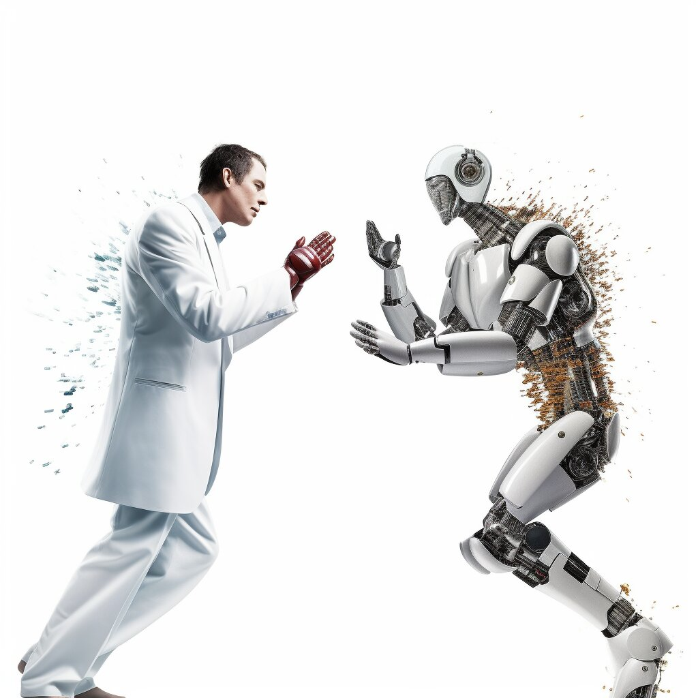
Outline
Automation in medicine
Medical AI today
Issues in implementing AI in daily clinical practice
Empathy
Resistance to medical AI
Privacy
Conclusions

Slide 3
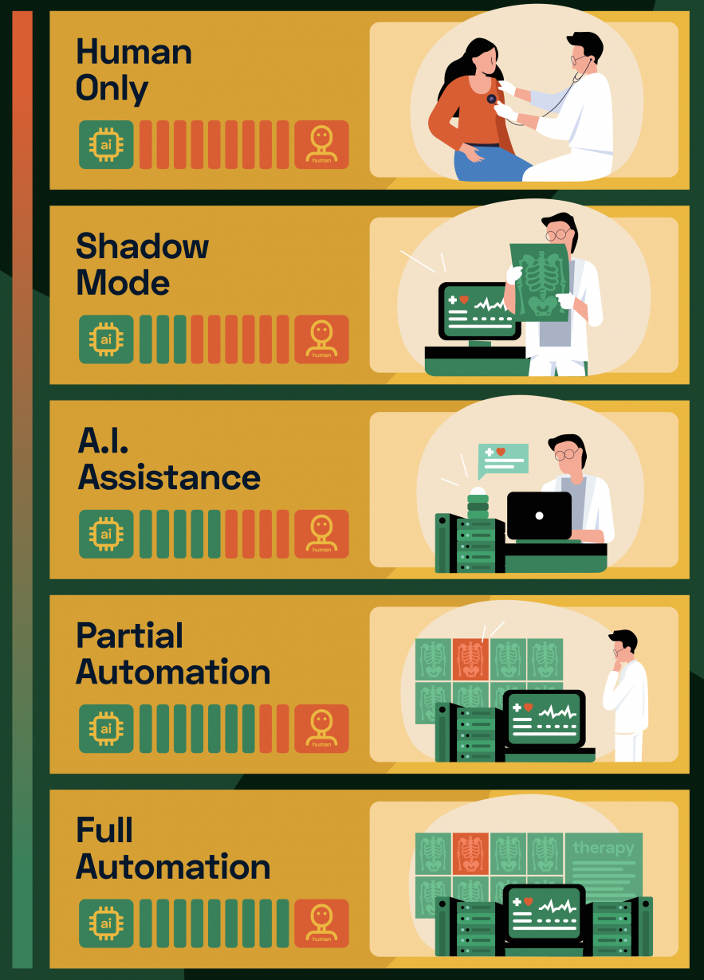
The 5 Levels of Automation in Medicine
[1]
Humans only: no AI involved
Shadow mode: the physician teacher and the AI student
The AI assistant
Partial automation
Full automation
The role of the doctor is essential in medical practice, as there are many issues to consider when implementing AI.

Slide 4
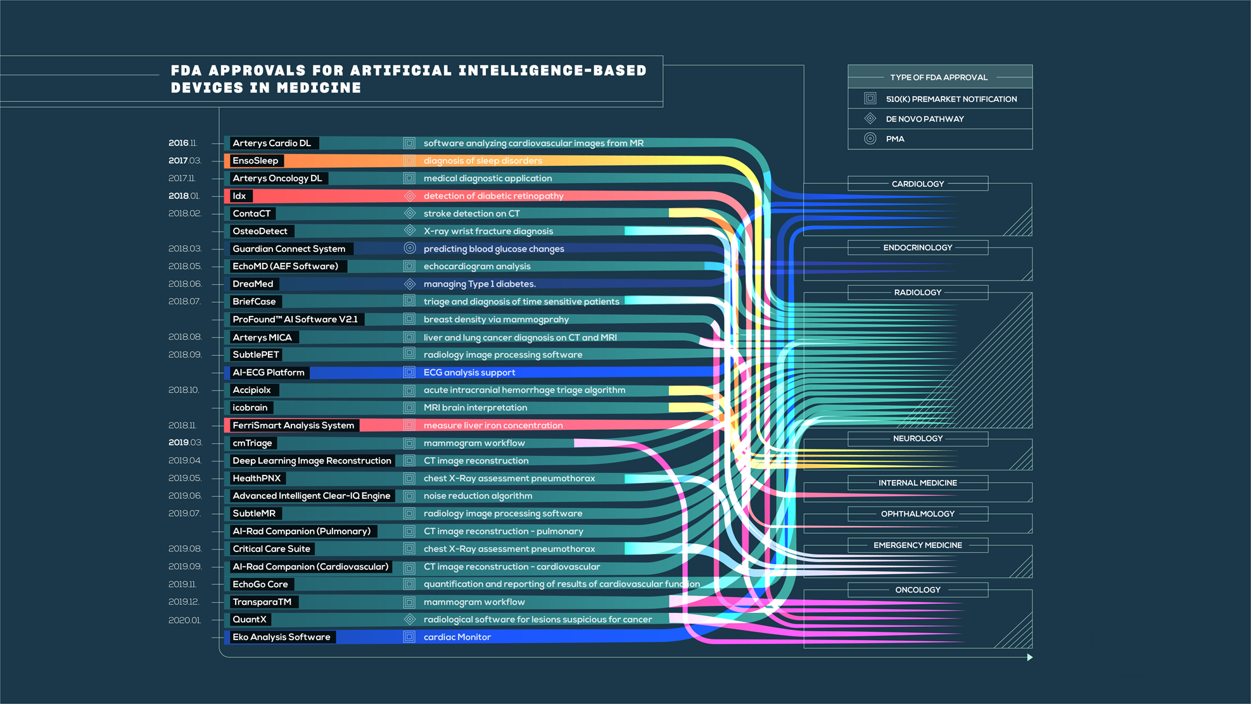
[2]
Notes:
Insight into the currently available AI/ML-based medical devices and algorithms that have been approved by the US Food & Drugs Administration (FDA).

Slide 5
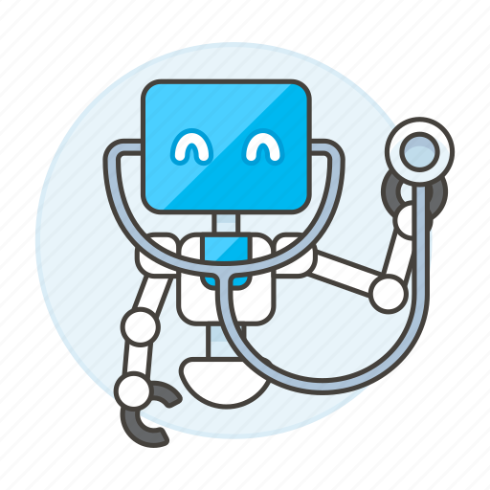
Tasks where AI outperforms doctors
Anomaly Detection
Disease Prediction
Precision Medicine
24/7 Monitoring
There's no doubt about it:
Artificial intelligence is and will be beneficial to healthcare.

Slide 6
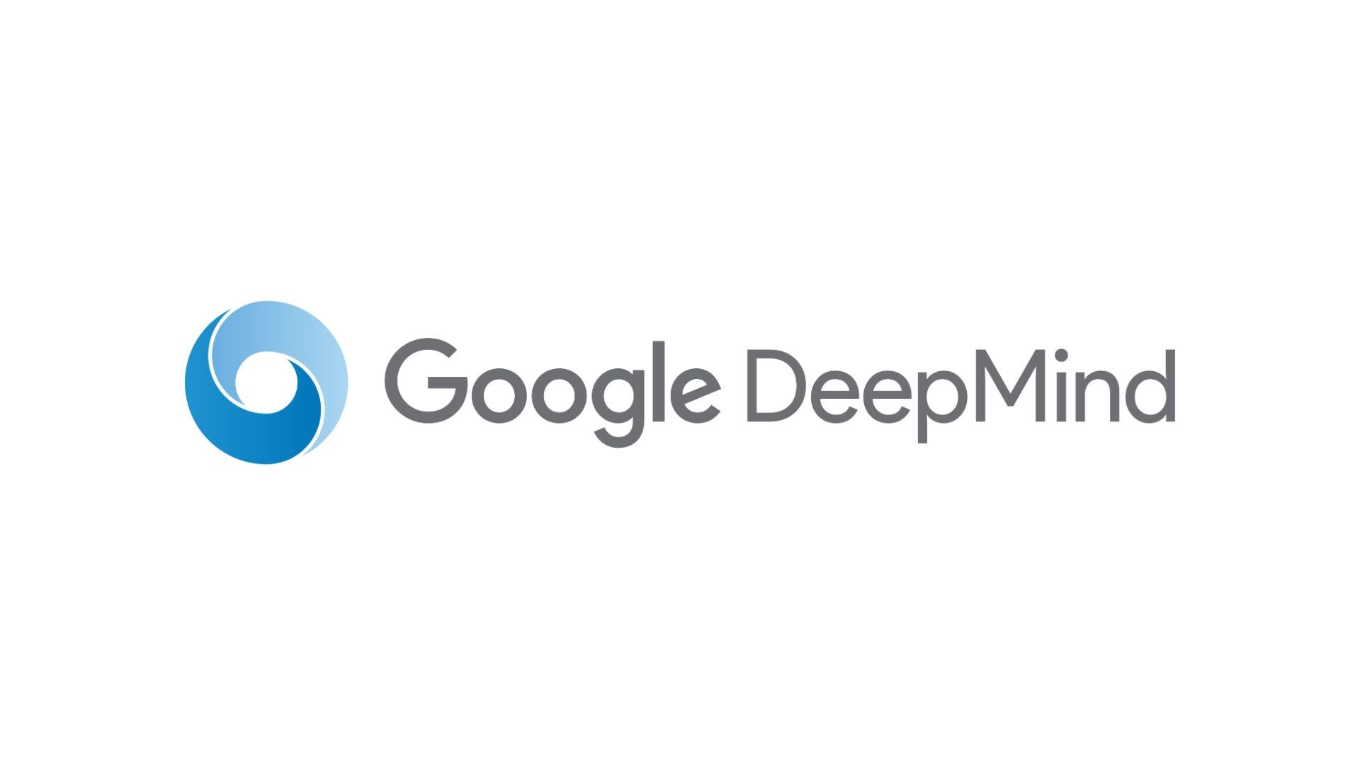
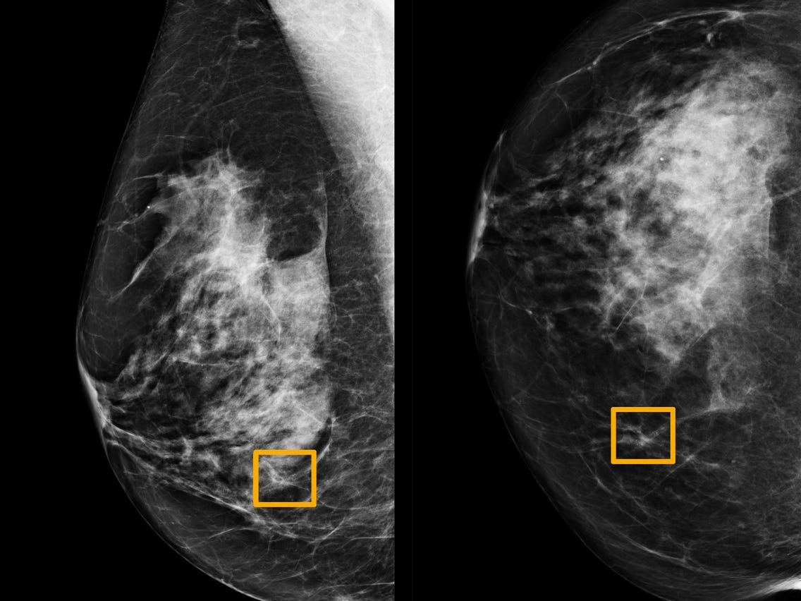
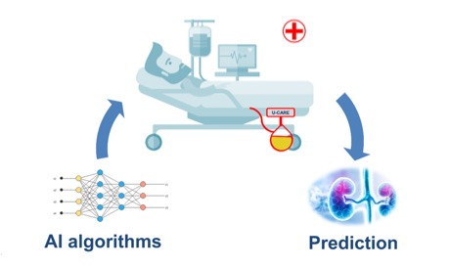
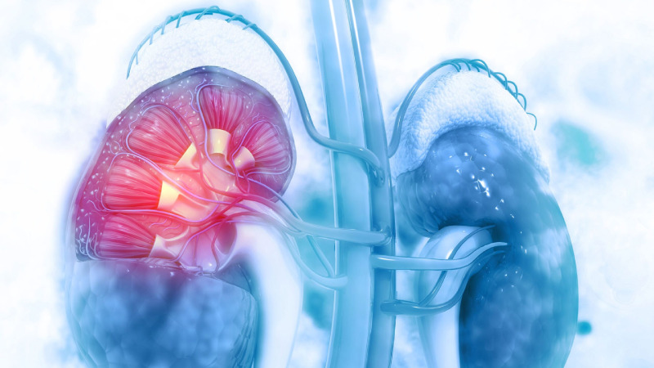
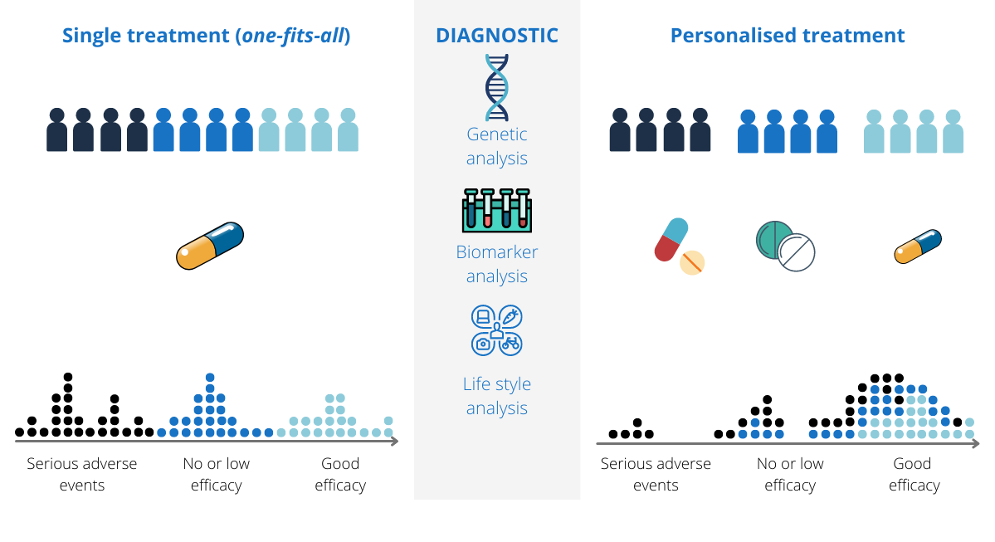

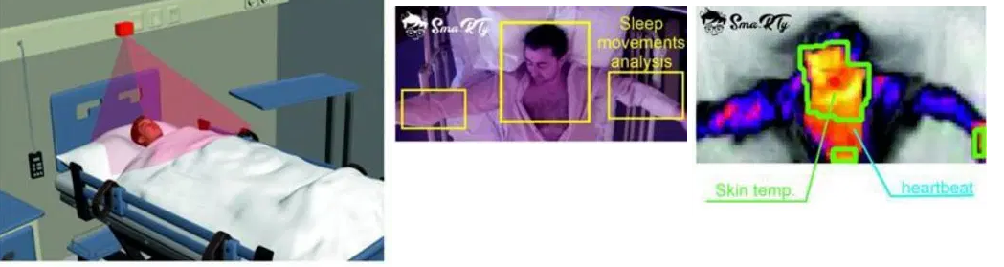
Tasks where AI outperforms doctors
[3]
Anomaly Detection
Disease Prediction
Precision Medicine
24/7 Monitoring
There's no doubt about it:
Artificial intelligence is and will be beneficial to healthcare.

Slide 7

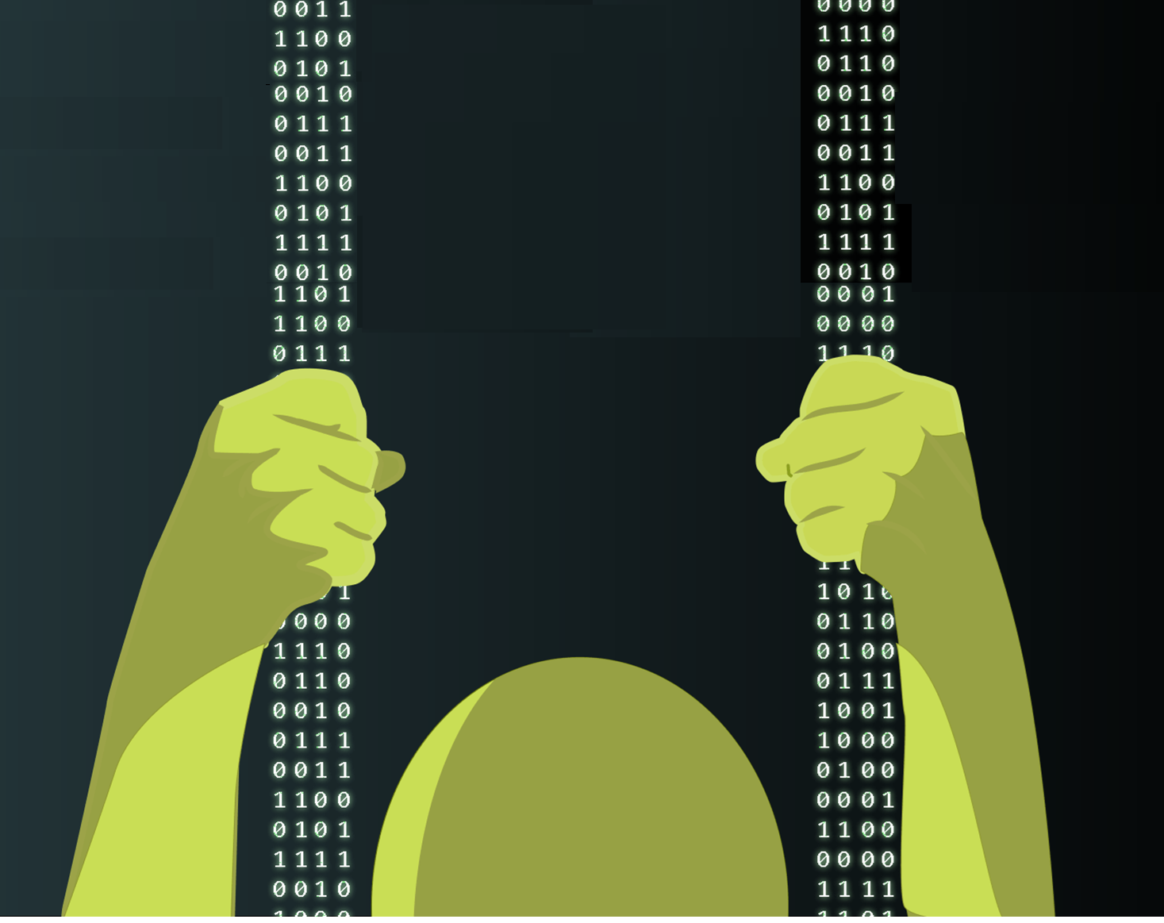
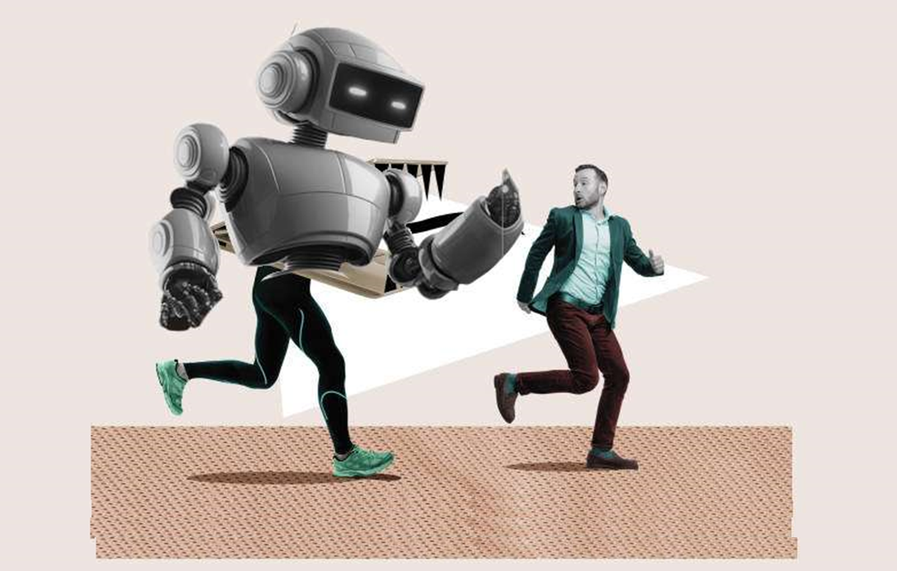

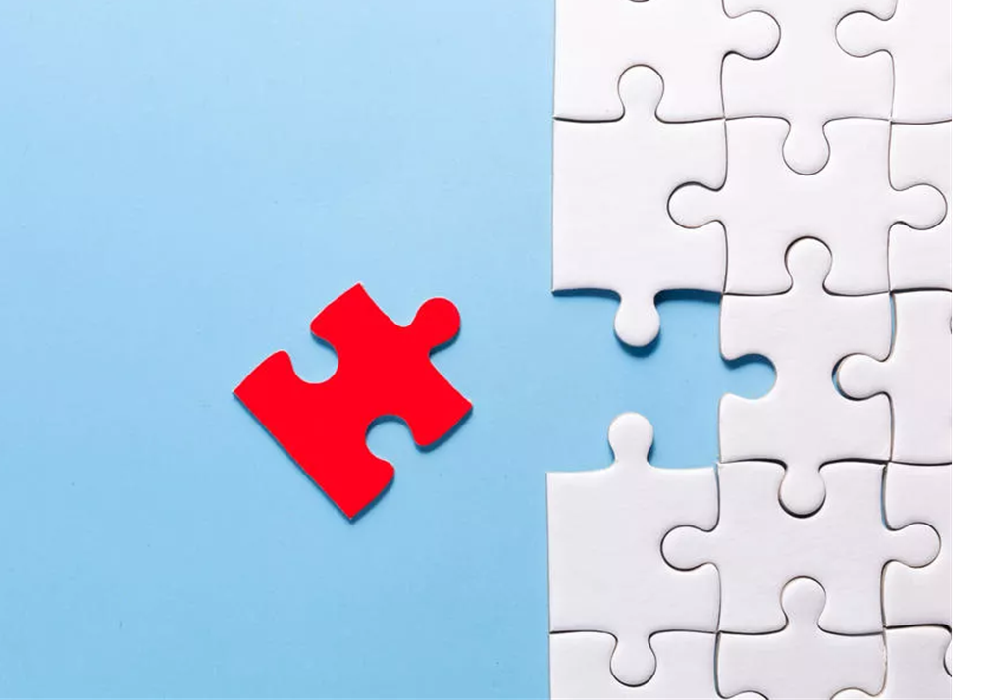
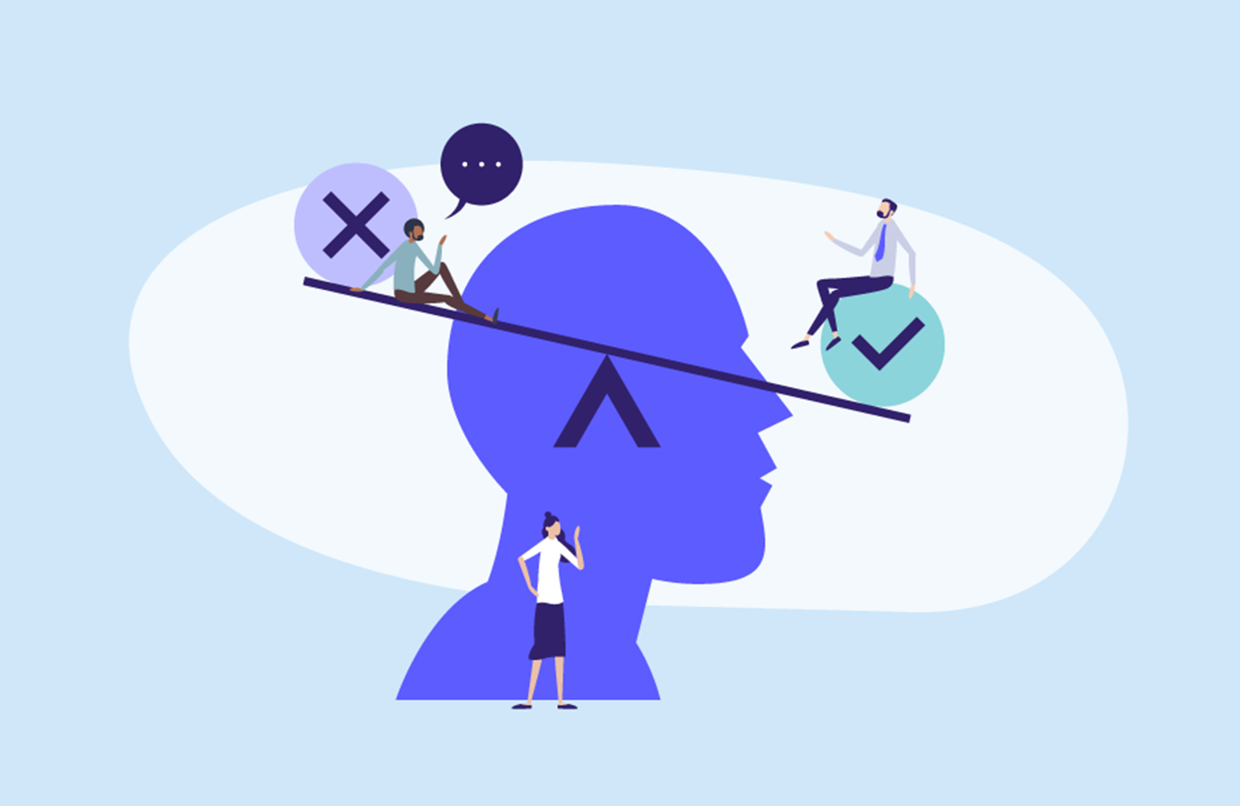
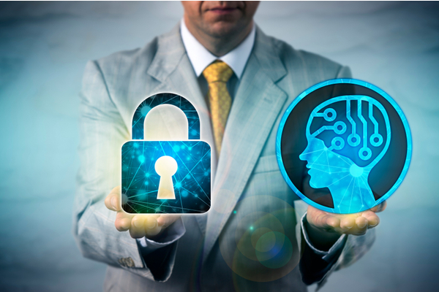
Issues in implementing AI in daily clinical practice
‘Empathy’
Accountability
Resistance to Medical AI
Explicability
Lack of Data
Privacy
Bias

Slide 8
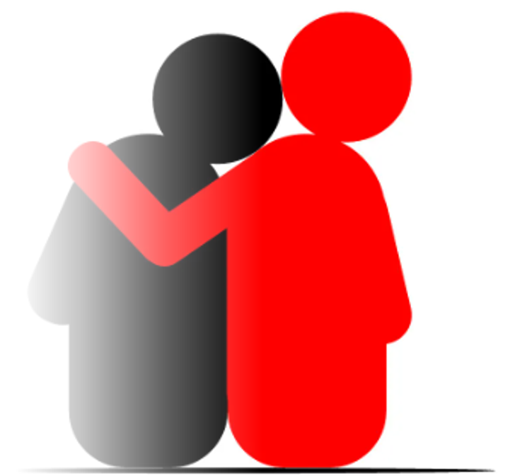
Empathy
“Any clinical examination requires a sense of compassion and empathy, which will not be achieved with robotic doctors.” [4]
Farhud, Zokaei

Slide 9
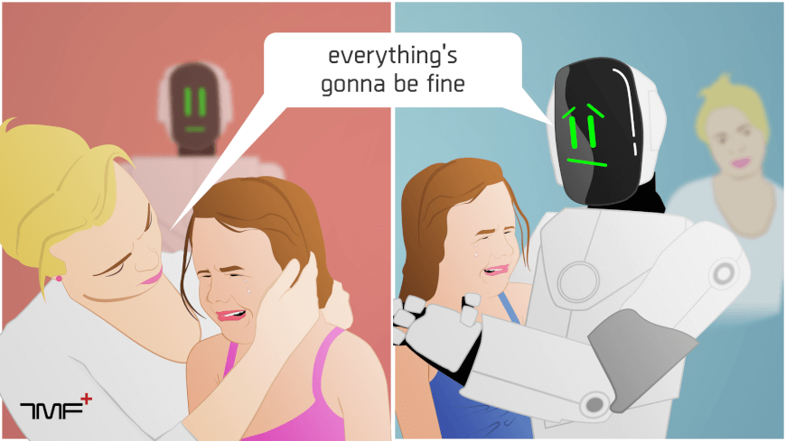
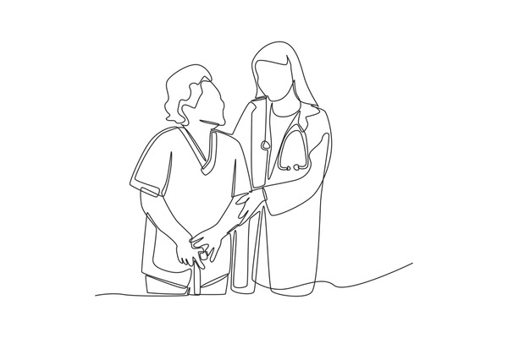
Empathy in healthcare
“Machine interactions in hospitals and similar care-based situations can achieve some neighboring phenomenon, but cannot, in principle, achieve empathy." [4]
Human empathy' s benefits:
Getting accurate history;
Effective medical care;
Helping patients to cope with bad news in a better way;

Slide 10
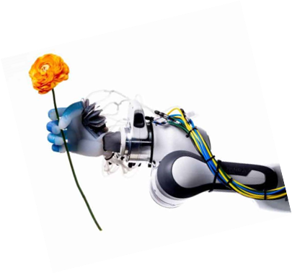

Empathy in healthcare
“Machine interactions in hospitals and similar care-based situations can achieve some neighboring phenomenon, but cannot, in principle, achieve empathy." [4]
“AI cannot provide empathic attention, genuine care for humans —
at best, they can provide emotionally unengaged care through representations and rules about cases.” [4]

Slide 11
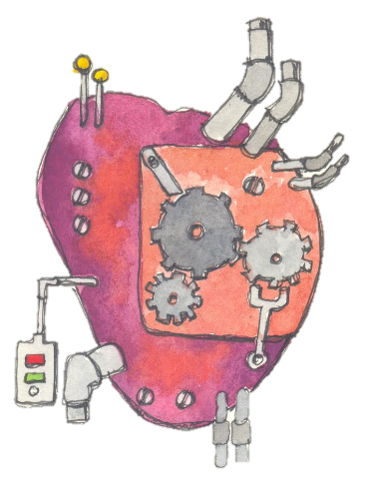
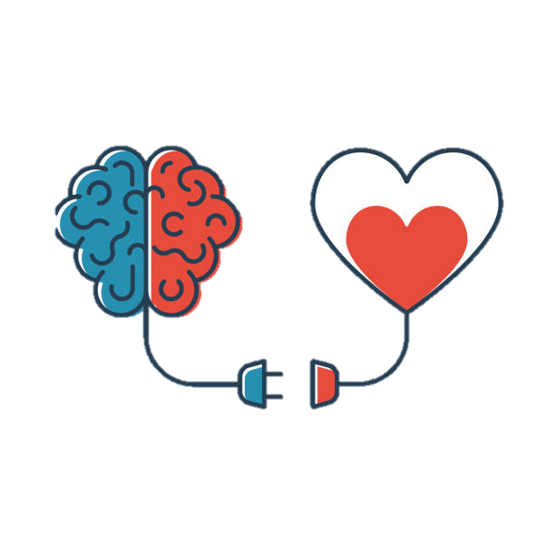
Objection
“Even if the genuine article cannot be reproduced by AI, one can still defend an empathic AI program, because coming close to real empathy is good enough to put the attempt on solid footing.” [4]
However as shown in the research of Ruosi Shao (University of Oklahoma Health Sciences Center Oklahoma City):
“In this study, we tested the effectiveness of an AI-driven virtual counselor named Becky for providing empathetic counseling, using a human-operated condition as a reference.” [5]
“Therefore, before equipping non-human agents with the capacity to empathize, it is important to take a step back and consider what aspects of empathy can be perceived and well-accepted by humans when coming from a non-human agent” [5]

Slide 12
Resistance to Medical AI
Uniqueness neglect
"AI providers are less able than human providers to account for consumers’ unique characteristics and circumstances" [13]
"patients believe that their medical needs are unique and cannot be adequately addressed by algorithms" [16]
Some people think that they differ from the average person. [14]
An answer of an AI system is seen as a one-fits-all option for the average person, so it is perceived as less accurate than a human answer. [14]
Notes:
An important point to discuss related to empathy is the Resistance towards Medical AI. Patients are, in fact, reluctant to use health care provided only by artificial intelligence algorithms even if it outperforms human doctors. They also are willing to pay more for a human doctor than an AI one, even if the performance is the same.
->
The cause of this resistance is known as uniqueness neglect and it is of recent conceptualization.
->
There is the belief that AI does not take into account one’s idiosyncratic characteristics. According to Harvard Business Review "patients believe that their medical needs are unique and cannot be adequately addressed by algorithms”.
->
Some people, in fact, think that they differ from the average person (for example, in terms of the side effects of a cure). An answer of an AI system is seen as a one-fits-all option for the average person, so it is perceived as less accurate than a human answer (while it could, in theory, be more precise and tailored to the patient, thanks to the large quantities of data that algorithms can use to make diagnosis and predictions).
->

Slide 13
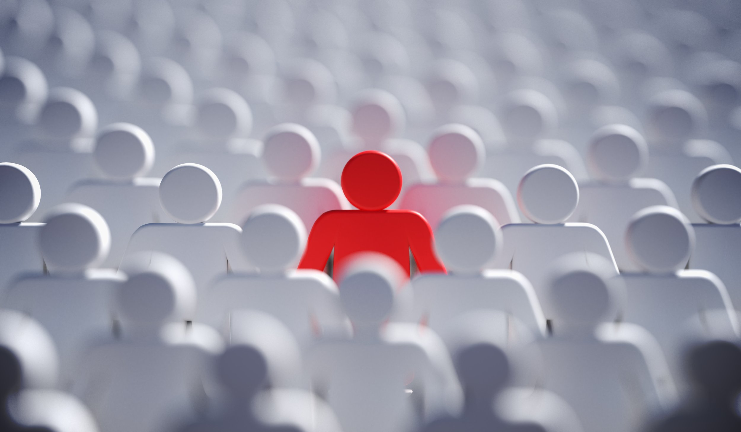
Individuation effects
Distrust and the lack of humanistic care in AI are primary reasons for negative attitudes towards this kind of AI.
Individuation
The recognition of unique information about a patient that sets them apart from others.
Notes:
->
We found a study on the individuation effects of AI vs. Human Doctors which highlight the fact that distrust and the lack of humanistic care in AI systems are primary reasons for negative attitudes towards this kind of AI.
->
By individuation, we mean the recognition of unique information about a patient that sets them apart from others.

Slide 14
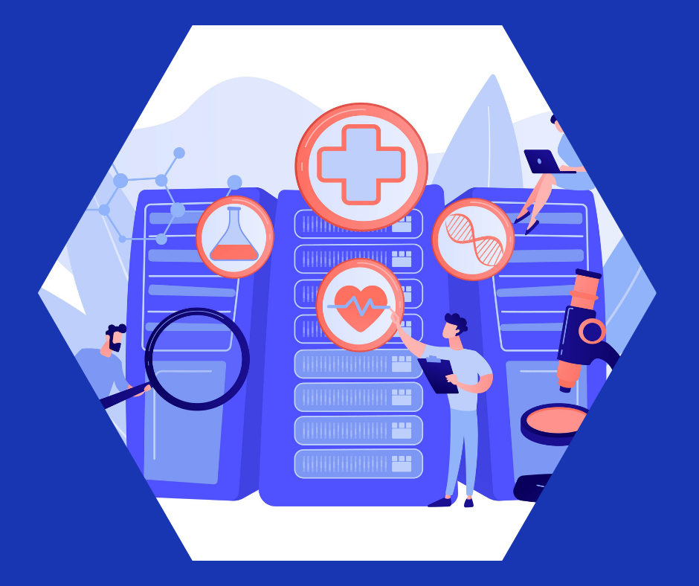
Study on the individuation effects
Do You Feel Special When an AI Doctor Remembers You?
Individuation Efects of AI vs. Human Doctors on User Experience [15]
E-Health platform
Three types of chatbots
Human doctor
AI doctor
AI-assisted human doctor
Individuation condition randomly assigned
Notes:
The study focuses on an e-health platform -> during the Covid-19 pandemic. In particular, users were asked to interact with a doctor for the first time on an online chat.->Participants were randomly assigned to interact with one of the three available chatbots:
the first one presented itself as a human doctor
the second one an AI doctor
the third one an AI-assisted human doctor
Actually, all of them were bots.
After the first interaction, participants were asked to interact again 10 days later with the same type of doctor they were assigned before.->In this second chat, each participant was randomly assigned to the individuation or non-individuation condition:
the chatbot with the individuation condition enabled was able to refer to specific patient information that was collected in the previous chat (preferred name, diseases, hand washing habits)
the other type of chatbot was able to provide only generic answers, unrelated to the individual patient.

Slide 15
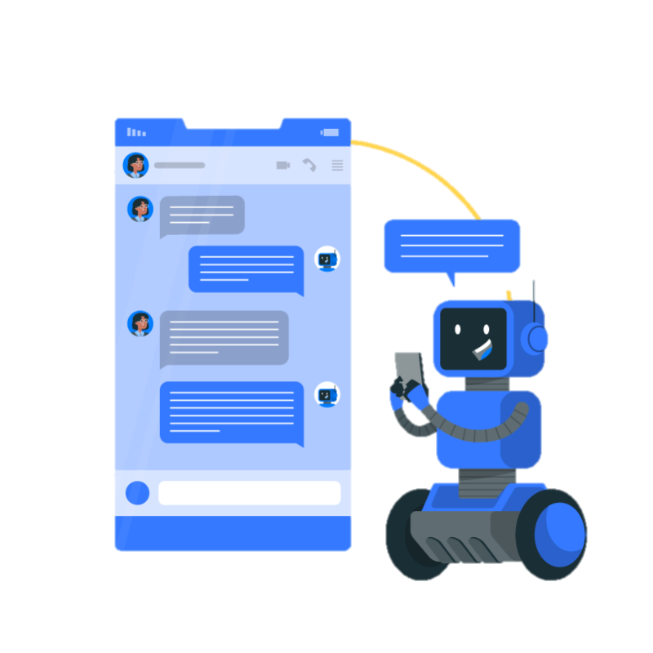
Conclusions of the study
The "human" chatbot failed to disguise its identity: humans need more time to construct long texts.
"individuation coming from a human doctor is appreciated whereas that coming from an AI doctor is perceived as too intrusive and therefore unappreciated" [15]
Individuation is unique to human-to-human interactions.
All the attempts of an AI system are "[…] a disingenuous attempt at caring and closeness". [15]
This leads to lower compliance to the medical advice given by automated systems.
Notes:
The first finding that it is analysed is that the majority of participants in the human doctor condition thought that they interacted with an AI doctor instead of a human one.->So, the “human” chatbot failed to disguise its identity. This is probably, according to the authors of the study, because all the chatbots (including the “human” one) were designed to send responses with a few seconds delay, and this could have made the responses appear artificially written (since humans usually need more time to construct long texts). Also, the repetitiveness of messages and the rigid advices are more indicative of a machine than a human.
->
The most interesting result is perhaps the different reaction to the individuation condition: “individuation coming from a human doctor is appreciated whereas that coming from an AI doctor is perceived as too intrusive and therefore unappreciated”. This also opens some questions regarding how privacy is perceived by patients.
->
The conclusion is that there is the belief that AI systems cannot interact with patient socially and individuation is unique to human-to-human interaction, so all the attempts of an AI are “a disingenuous attempt at caring and closeness”. This is shown to lead to lower compliance to the medical advice given by automated systems.

Slide 16
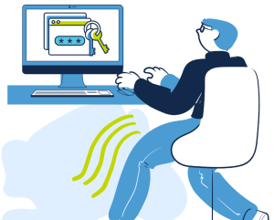
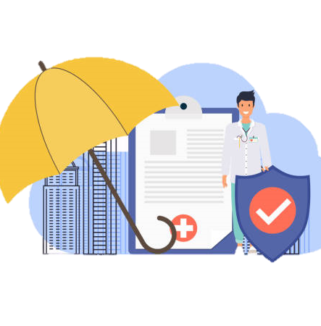

Privacy

Slide 17
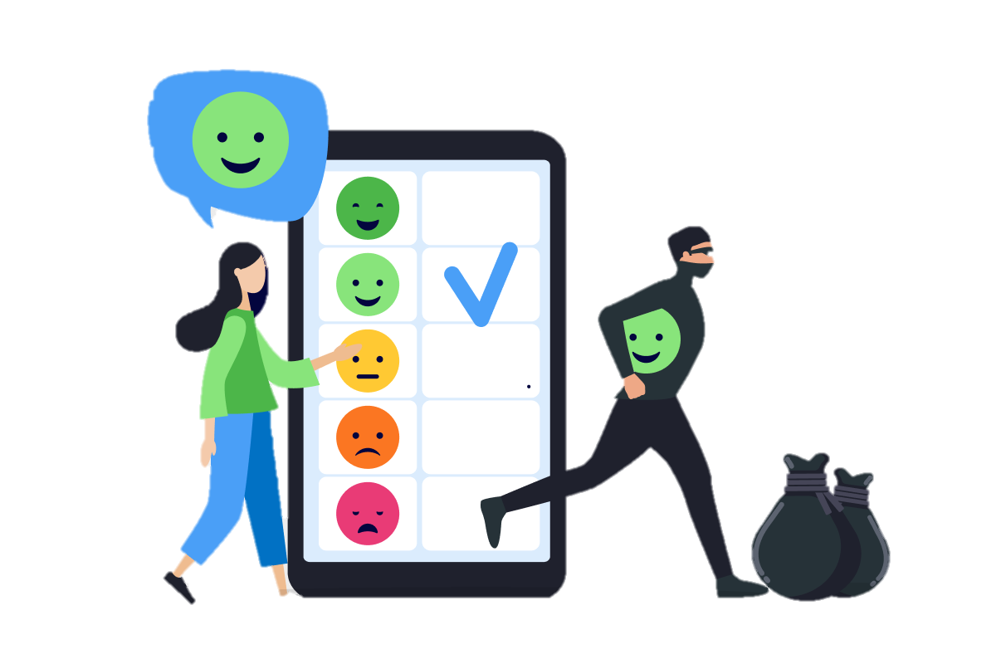
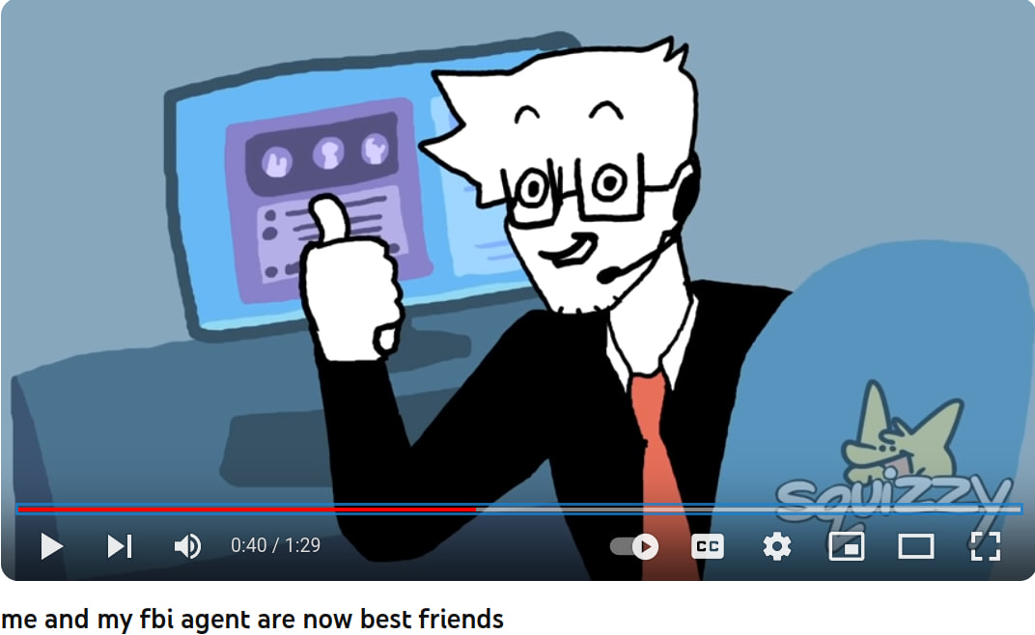


Why care about privacy?
"I got nothing to hide!" - Snowden (before working for the CIA)
"Yeah, your life's actually pretty boring" - your FBI agent
Source: The Snowden papers

Slide 18
Privacy is completely absent in the modern age
Anything that you do is tracked, analyzed, aggregated and sold on a market
Private searches,
Medical searches,
Google map trips,
Emails,
Job applications,
Bank transactions,
Clickthroughs (cookies),
Camera,
voice inflection,
Pokemon go trips,
Car trips,
...

Slide 19
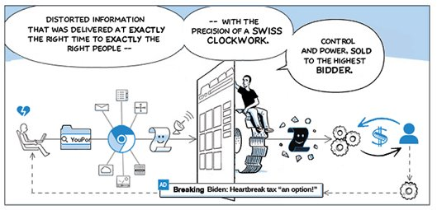
Information flow is highly asymmetric

Slide 20
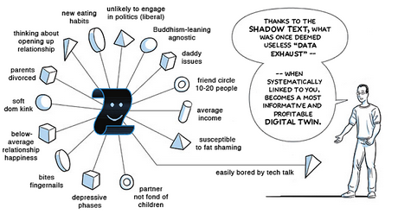
Information flow is highly asymmetric

Slide 21
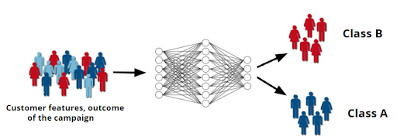
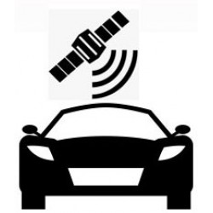

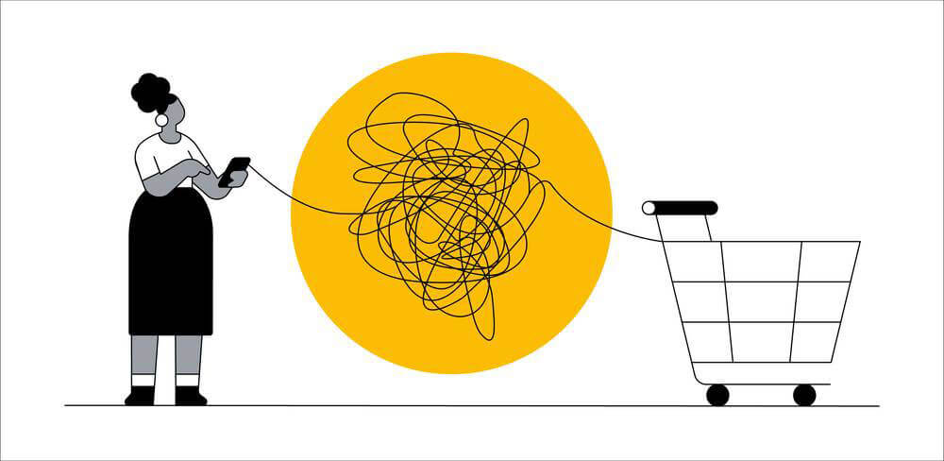

The dominant economic model in the tech industry is selling behaviour predicting products based on big data. [10]
Even more traditional industries are adapting. Ford is now adding trackers to their cars. [10] [11]
Google almost only makes money in this way. It is still able to due to lack of awareness. [10]

Slide 22
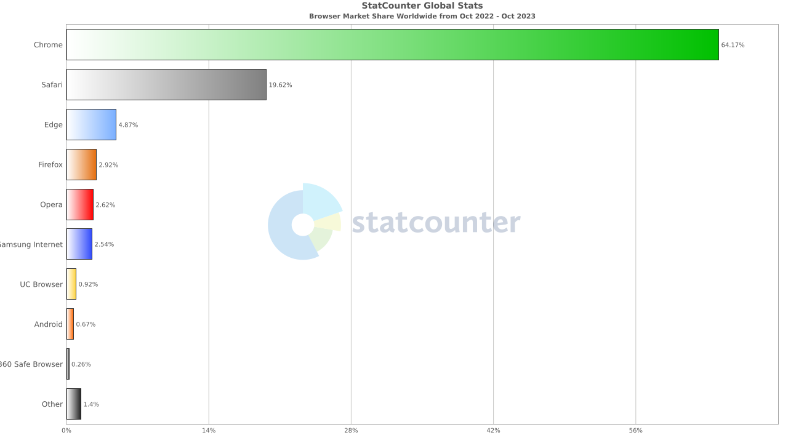
Awareness: Most people still use Chrome

Slide 23
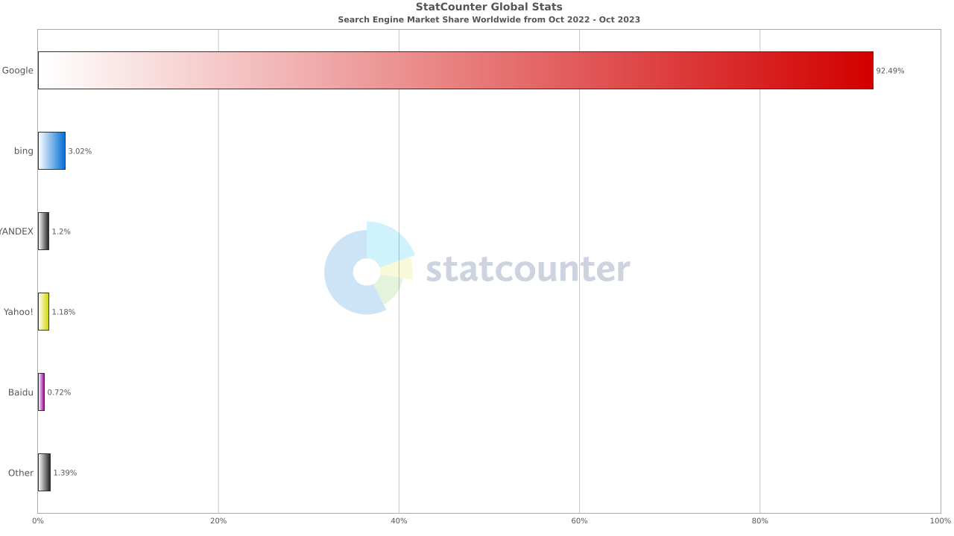
Awareness: Most people still use Chrome

Slide 24
Medical privacy is becoming online privacy
"Of the 41 apps (19%) with privacy policies, not all of the provisions actually protected privacy ... 80.5% collected user data … 48.8% shared data … Only 4 policies said they would ask users for permission to share data." [9]

Slide 25
Again, people are unaware
"Patients might mistakenly believe that health information entered into an app is private (particularly if the app has a privacy policy), but that generally is not the case. Medical professionals should consider privacy implications prior to encouraging patients to use health apps." [9]

Slide 26
Social context and unwritten trust
A survey of over 2000 people with a medical condition found that nearly all would be willing to share social media information with their doctors (94%), researchers (92%) and drug companies (84%) if it would improve their car.
(Kasperbauer 2020) [9]

Slide 27
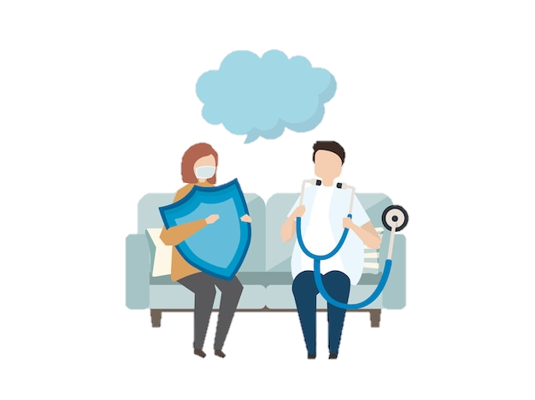
The role of the doctor
Doctors culturally evoke an atmosphere of confidentiality.
People trust them to keep their medical histories a secret.
People selectively choose which information to reveal in an instinctive manner that is appropriate to the social context at hand (doctor-patient interaction)
As has been shown, this is NOT true for medical apps.
Thought of as "private sources of information"
Google searches seem private
ChatGPT queries seem private
Medical apps seem private
Etc...
So this probably won't be true for AI systems that aid doctors in diagnosis?

Slide 28
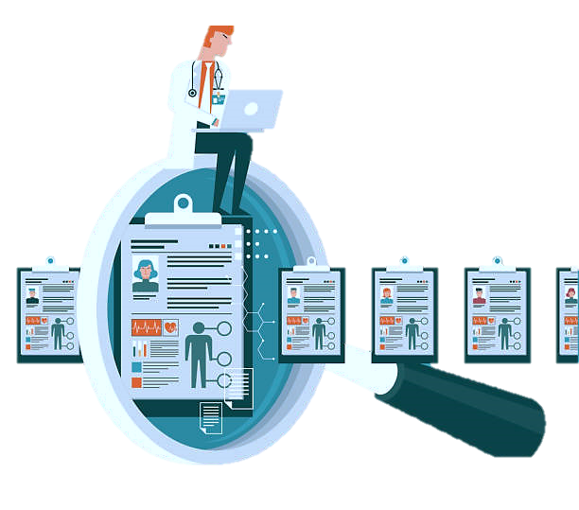
Philosophical and legal overview of medical privacy
"Western philosophers defend confidentiality on several utilitarian or other consequentialist grounds." [12]
They argue that preventive medicine, early diagnosis and treatment save human lives and money.
Individuals will be more inclined to get medical attention if they believe they can do so privately.
"Policy experts maintain that the cost of health care and insurance would be considerably higher if people avoided routine check-ups and prompt medical attention because confidentiality was not credibly promised." [12]

Slide 29
Tradition of privacy protection in medical outlines
Health care professionals acknowledge ethical duties to keep medical information private
(APA 2017; AAMFT 2015) [12]
Confidentiality practices remain salient in medical settings, even as members of the general public display more relaxed attitudes about voluntarily sharing health and medical information
(SEOP) [12]

Slide 30
So there is both written and uwritten trust inherent to medical institutions, born from a tradition of effective care and prevention, that is now being completely violated, without people being aware
Written and Uwritten Trust inherent to Medical Institutions

Slide 31
Who has access to the data?
"We only have a handful of institutions that can deal with massive digital data. And they are all privately owned by surveillance capitalists." [10]
Selling data for ad revenue is the dominant economic paradigm in the tech sector [10]

Slide 32
Awareness of social good
"The Republic protects health as a fundamental right of the individual and interest of the community, and guarantees free treatment to the indigent…"
Article 32 – Italian constitution

Slide 33

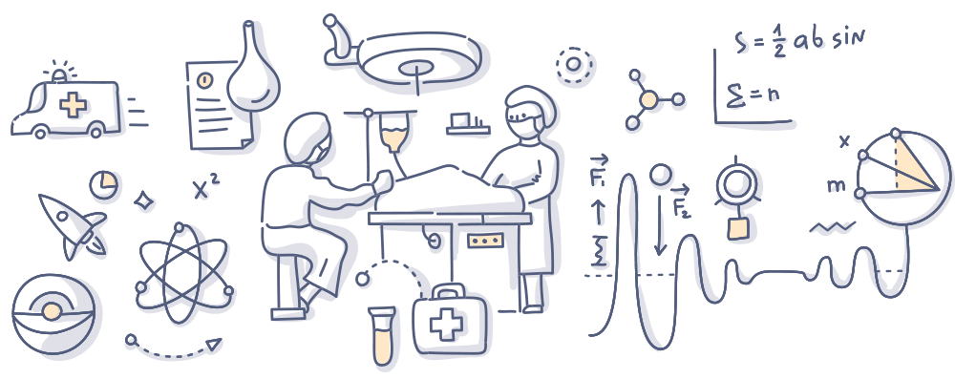
We claimed that doctors shouldn't be replaced by algorithms. Medical institutions shouldn't either.

Slide 34
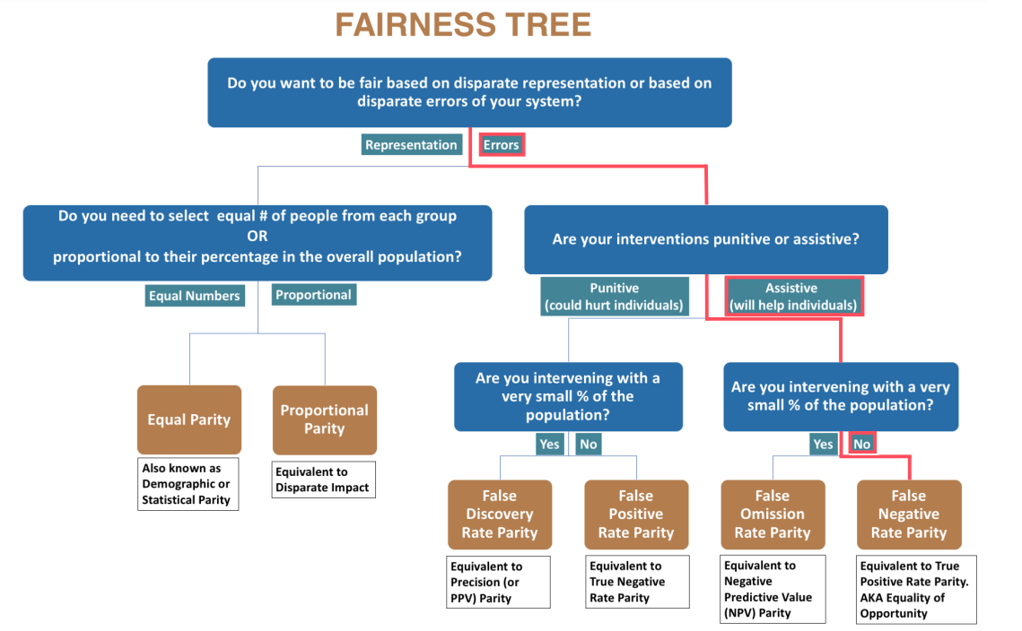
Bias
Bias in algorithm
We have done a work on diabete that might be interesting as an example:
https://github.com/SimoneCallegarin/TIS_project
Paper: https://arxiv.org/pdf/1811.05577v2.pdf (In brief: use of the AEQUITAS toolkit to audit fairness in a medical database)

Slide 35
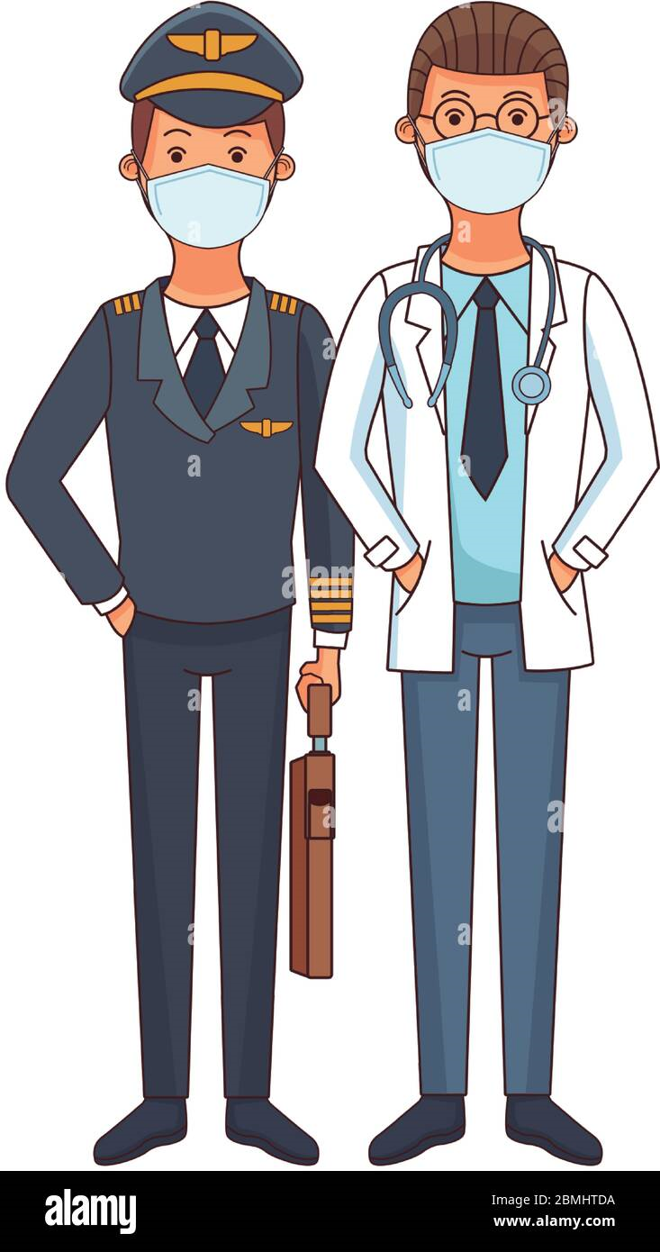
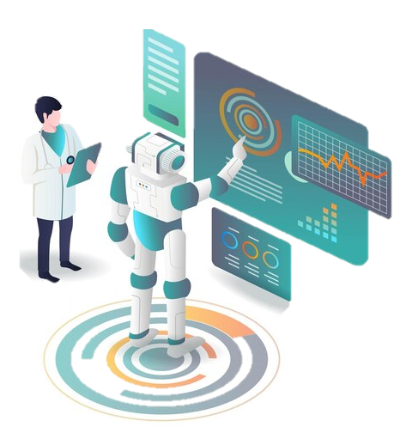
Conclusions
"As autopilot in aviation. The innovation did not replace real pilots, it only augmented their tasks. On very long flights, it is handy to turn on the autopilot, but they are useless when you need rapid judgment.
So, the combination of humans and machines is the winning solution. And it will be the same in healthcare." [6,7]
AI and medical professionals show better results when they complement each other rather than work in isolation.

Slide 36
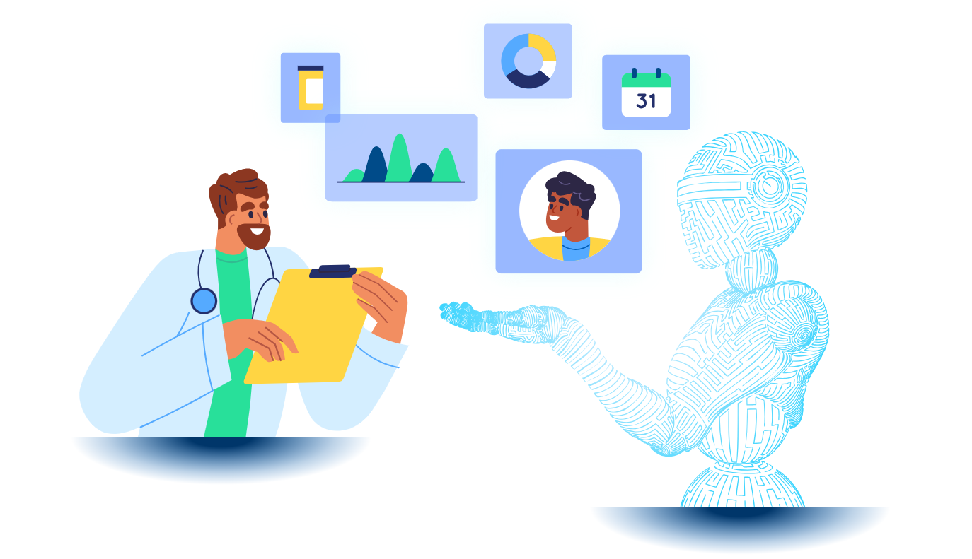
AI professionals
"With AI, it is easier for medical professionals to care for a larger number of patients. AI tools help them make better diagnostic decisions, improve treatment outcomes and reduce medical errors." [8]

Slide 37
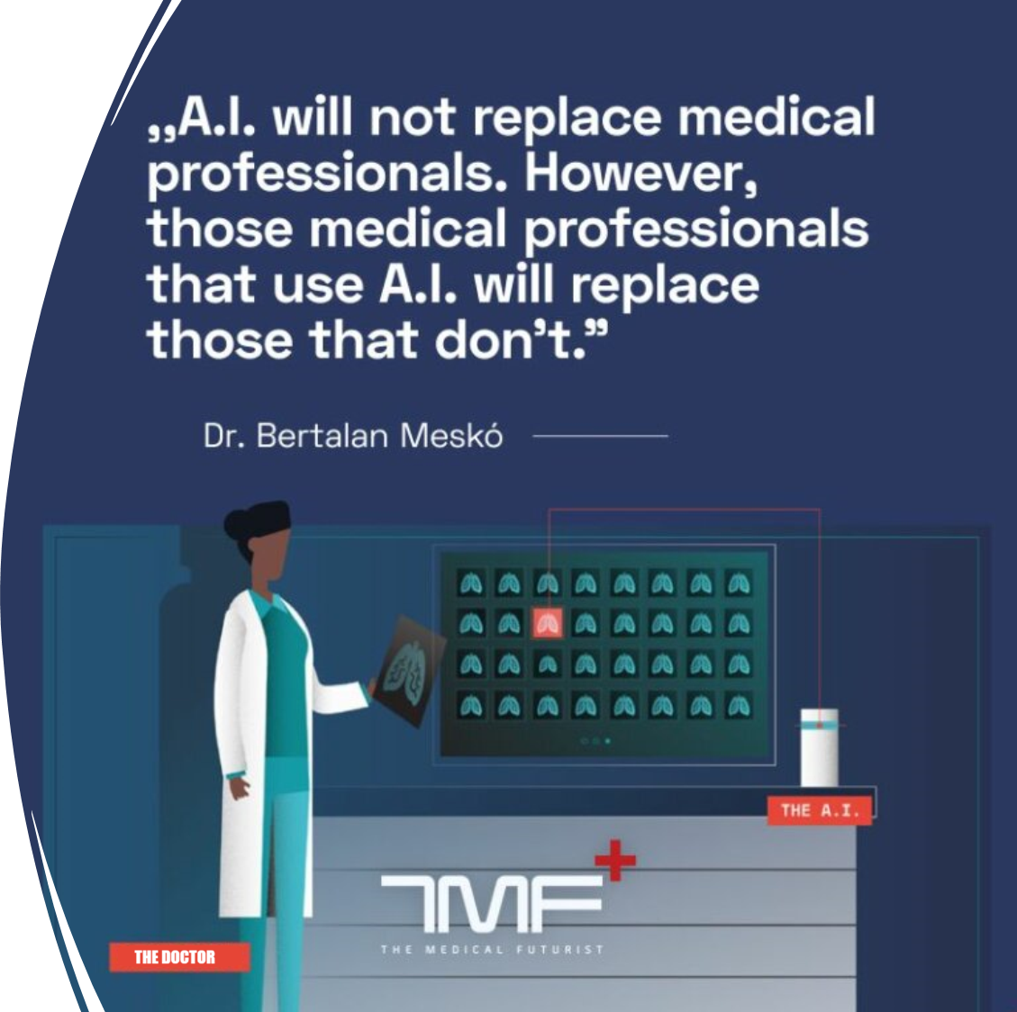
AI professionals
"With AI, it is easier for medical professionals to care for a larger number of patients. AI tools help them make better diagnostic decisions, improve treatment outcomes and reduce medical errors." [8]
"AI is not meant to replace medical professionals, but the ones using AI will probably replace those who don’t." [8]

Slide 38
References
Andrew Ng. "The batch" from deeplearning.ai. February 24, 2021.
Benjamens, S., Dhunnoo, P. & Meskó, B. The state of artificial intelligence-based FDA-approved medical devices and algorithms: an online database. npj Digit. Med. 3, 118 (2020).
FasterCapital Transforming Healthcare with AIB: Innovations for Better Patient Care chapter 1. The Role of Artificial Intelligence in Healthcare. November 12, 2023.
Montemayor, C., Halpern, J. & Fairweather, A. In principle obstacles for empathic AI: why we can’t replace human empathy in healthcare. AI & Soc 37, 1353–1359 (2022).
Ruosi Shao, An Empathetic AI for Mental Health Intervention: Conceptualizing and Examining Artificial Empathy. May 18, 2023.
Viz.ai, Healthcare AI Trends White Paper, Revolutionizing Healthcare. June 2023.
Langlotz, Curtis P. Will Artificial Intelligence Replace Radiologists?. May 15, 2019.
Meskó B, Hetényi G, Győrffy Z. Will artificial intelligence solve the human resource crisis in healthcare? BMC Health Serv Res (conclusion only). July 13, 2018.

Slide 39
References
Sarah R. Blenner, Melanie Köllmer, Adam J. Rouse. Privacy Policies of Android Diabetes Apps and Sharing of Health Information. March 8, 2016
Zuboff, S. (2019). The Age of Surveillance Capitalism: The Fight for a Human Future at the New Frontier of Power. PublicAffairs.
Matt Burgess. How Your New Car Tracks You. Wired Magazine. June 21, 2023.
Allen, Anita, Privacy and Medicine, The Stanford Encyclopedia of Philosophy (Spring 2021 Edition), Edward N. Zalta (ed.)
Chiara Longoni, Andrea Bonezzi, Carey K. Morewedge, Resistance to Medical Artificial Intelligence, Journal of Consumer Research, Volume 46, Issue 4, December 2019, Pages 629–650
S. Wood, K. Schulman, Beyond politics – promoting Covid-19 vaccination in the United States, February 18, 2021
Jin Chen, Cheng Chen, Joseph B. Walther, S. Shyam Sundar, Do You Feel Special When an AI Doctor Remembers You? Individuation Effects of AI vs. Human Doctors on User Experience, Association for Computing Machinery, Article 299, 1–7
Chiara Longoni, Carey K. Morewedge, AI Can Outperform Doctors. So Why Don’t Patients Trust It?, October 30, 2019

Slide 40
Other slides di prova
(Ignore)

Slide 41
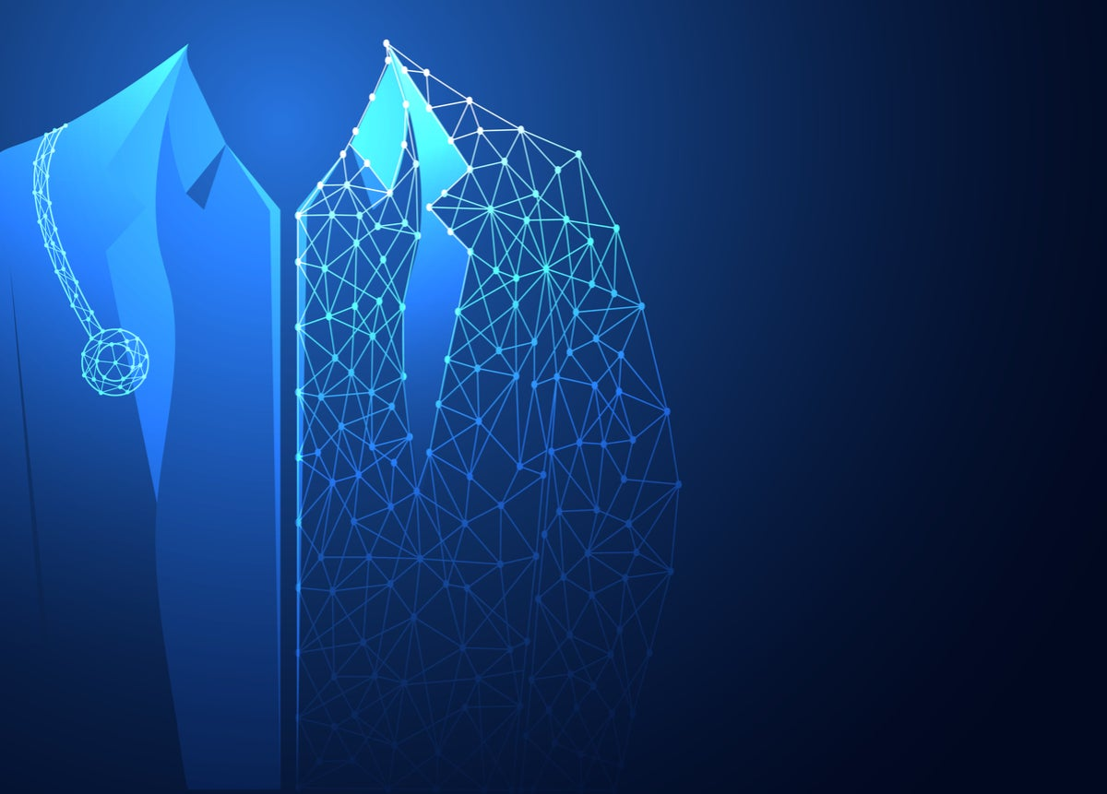
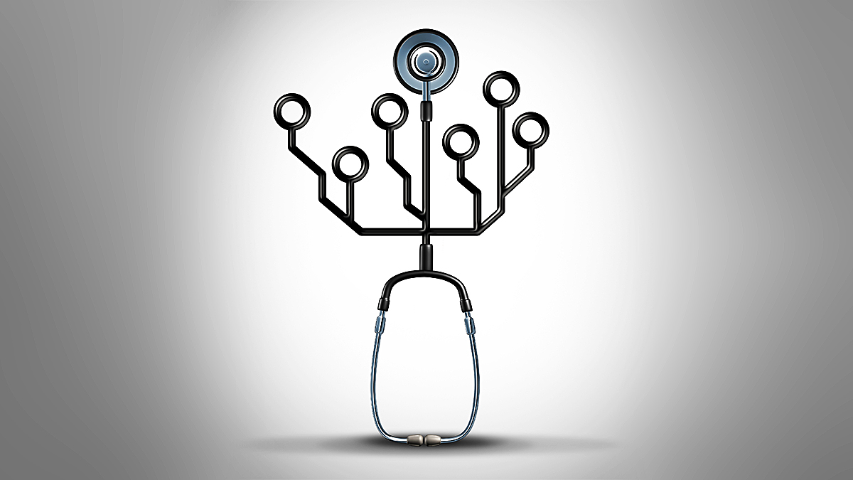
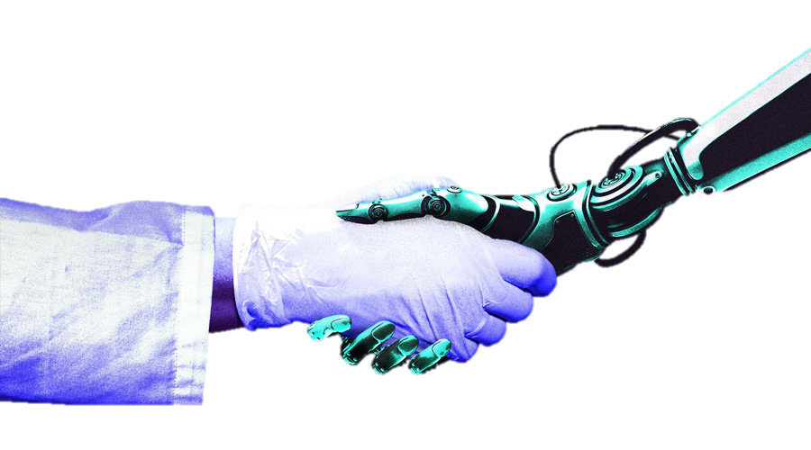
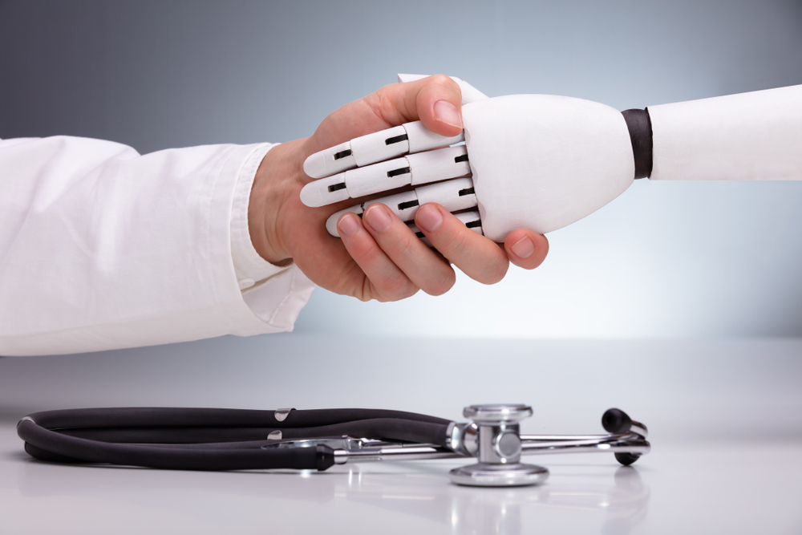
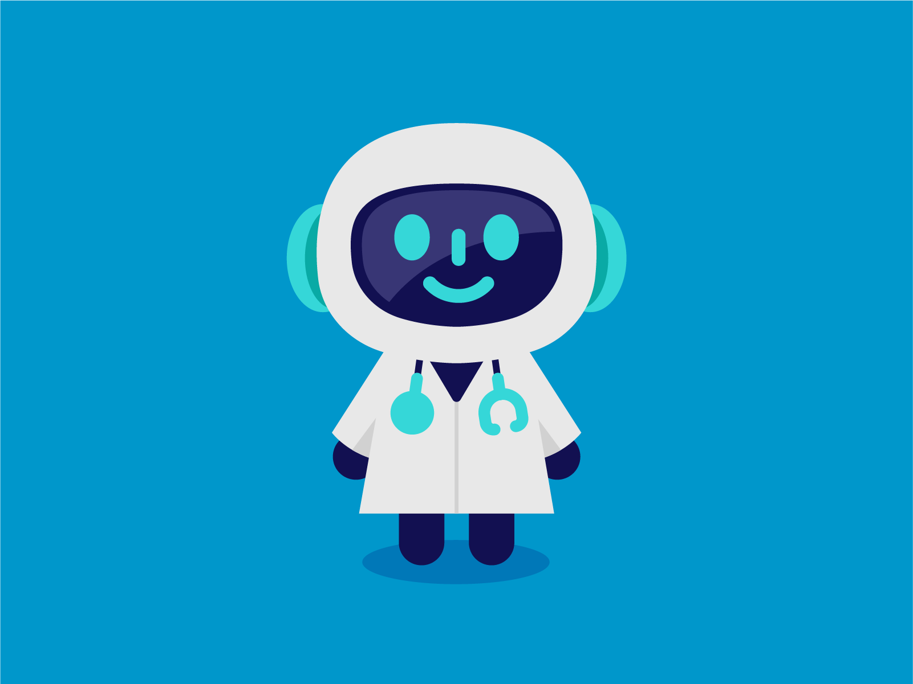



Other useful images:

Slide 42

Conclusions

Slide 43

Conclusions
"As autopilot in aviation. The innovation did not replace real pilots, it only augmented their tasks. On very long flights, it is handy to turn on the autopilot, but they are useless when you need rapid judgment.
So, the combination of humans and machines is the winning solution. And it will be the same in healthcare." [6,7]
AI and medical professionals show better results when they complement each other rather than work in isolation.
"With AI, it is easier for medical professionals to care for a larger number of patients. AI tools help them make better diagnostic decisions, improve treatment outcomes and reduce medical errors." [8]

Slide 44
AI as a support
"As autopilot in aviation. The innovation did not replace real pilots, it only augmented their tasks. On very long flights, it is handy to turn on the autopilot, but they are useless when you need rapid judgment.
So, the combination of humans and machines is the winning solution. And it will be the same in healthcare." [6,7]
AI and medical professionals show better results when they complement each other rather than work in isolation.
"With AI, it is easier for medical professionals to care for a larger number of patients. AI tools help them make better diagnostic decisions, improve treatment outcomes and reduce medical errors." [8]

Slide 45
AI as a support
"Pilots must assimilate a torrent of information from a plane’s sensors and from their own senses to make decisions on which human lives depend. Cockpits are designed to mitigate human failings and to complement the skills of pilots. [...]" [N]
"The vision for AI in radiology looks much like a cockpit. Detection algorithms will solve “needle in a haystack” search problems. [...] And so AI will elevate the cognitive universe of radiologists to the top of their license—exercising judgment, creativity, and empathy as they interpret images in partnership with AI algorithms and patients." [N]
AI and medical professionals show better results when they complement each other rather than work in isolation.

Slide 46
Issues in implementing AI in daily clinical practice
‘Empathy’
Accountability
Resistance to Medical AI
Explicability
Lack of Data
Privacy
Bias

Slide 47

Deception - ELIZA - Rule based chatbots confronta con moderni
ELIZA was designed to simulate Rogerian psychologist (non-directive but supportive therapist)
draw patient out by reflecting their statements back at them
People became deeply emotionally involved with ELIZA:
(one of Weizenbaum's staff asked him to leave room when she talked with ELIZA)
when it was suggested the will to store conversations for later analysis, people immediately pointed out privacy implications suggesting they were having quite private conversations with ELIZA despite knowing that it was just software.
It worried Weizenbaum that people confided in ELIZA:
were people misled about how much computers understood?
feared that society was making mistake in removing human from decisions and choice
Sherry Turkle studied users of ELIZA and other systems:
while human face-to-face interaction is vital to the human experience
humans also continue to develop relationships with artifacts
e.g. some users suggested they used ELIZA more like a diary, as a way to privately explore their thoughts

Slide 48
AI as a support
autopilot in aviation. The innovation did not replace real pilots, it only augmented their tasks. On very long flights, it is handy to turn on the autopilot, but they are useless when you need rapid judgment. So, the combination of humans and machines is the winning solution. And it will be the same in healthcare.

Slide 49
Privacy is completely absent in the modern age

Slide 50
Anything that you do is tracked, analyzed, aggregated and sold on a market
Private searches, medical searches, google map trips, emails, job applications, bank transactions, clickthroughs (cookies), camera, voice inflection, pokemon go trips, car trips, ...

Slide 51
Information flow is highly asymmetric

Slide 52


Slide 53
The dominant economic model in the tech industry is selling behaviour predicting products based on big data. [10]
Even more traditional industries are adapting. Ford is now adding trackers to their cars. [10][11]
Google almost only makes money in this way. It is still able to due to lack of awareness. [10]

Slide 54
Awareness: Most people still use Chrome

Slide 56
Medical privacy is becoming online privacy
"Of the 41 apps (19%) with privacy policies, not all of the provisions actually protected privacy ... 80.5% collected user data … 48.8% shared data … Only 4 policies said they would ask users for permission to share data." [9]

Slide 57
Again, people are unaware
"Patients might mistakenly believe that health information entered into an app is private (particularly if the app has a privacy policy), but that generally is not the case. Medical professionals should consider privacy implications prior to encouraging patients to use health apps." [9]

Slide 58
Medical privacy is becoming online privacy
"Mobile health apps can help individuals manage chronic health conditions. One-fifth of smartphone owners had health apps in 2012, and 7% of primary care physicians recommended a health app."
"In 2014, we identified all Android diabetes apps by searching Google Play using the term diabetes … Of the 41 apps (19%) with privacy policies, not all of the provisions actually protected privacy (eg, 80.5% collected user data and 48.8% shared data) (Table 1). Only 4 policies said they would ask users for permission to share data."
"Patients might mistakenly believe that health information entered into an app is private (particularly if the app has a privacy policy), but that generally is not the case. Medical professionals should consider privacy implications prior to encouraging patients to use health apps."
(https://jamanetwork.com/journals/jama/article-abstract/2499265)

Slide 59
Social context and unwritten trust
A survey of over 2000 people with a medical condition found that nearly all would be willing to share social media information with their doctors (94%), researchers (92%) and drug companies (84%) if it would improve their care (Kasperbauer 2020). [12]

Slide 60
Philosophical and legal overview of medical privacy
"Western philosophers defend confidentiality on several utilitarian or other consequentialist grounds." [N]
They argue that preventive medicine, early diagnosis and treatment save human lives and money.
Individuals will be more inclined to get medical attention if they believe they can do so privately.
"Policy experts maintain that the cost of health care and insurance would be considerably higher if people avoided routine check-ups and prompt medical attention because confidentiality was not credibly promised." [N]

Slide 61
Tradition of privacy protection in medical outlines
Health care professionals acknowledge ethical duties to keep medical information private (APA 2017; AAMFT 2015) [12]
Confidentiality practices remain salient in medical settings, even as members of the general public display more relaxed attitudes about voluntarily sharing health and medical information (SEOP) [12]

Slide 62
So there is both written and uwritten trust inherent to medical institutions, born from a tradition of effective care and prevention, that is now being completely violated, without people being aware

Slide 63

People don't value online privacy, but they do value medical privacy
"Medical confidentiality promotes the individual’s medical autonomy, by sheltering those seeking morally controversial medical care from outside criticism and interference with decisions." [N]
"Information-sharing has grown more common in recent decades—due, inter alia, to social media, big data, precision medicine, and increased infectious disease, new drug marketing and other health surveillance—individuals commonly keep some health concerns to themselves, whether out of personal preference, ethical reserve, etiquette, fear or shame." [N]

Slide 64
Who has access to the data?
"We only have a handful of institutions that can deal with massive digital data. And they are all privately owned by surveillance capitalists." [10]
Selling data for ad revenue is the dominant economic paradigm in the tech sector [10]

Slide 65
Awareness of social good
"The Republic protects health as a fundamental right of the individual and interest of the community, and guarantees free treatment to the indigent. No one can be forced to undergo a specific health treatment except by law. The law cannot under any circumstances violate the limits imposed by respect for the human person."
Article 32 – Italian constitution

Slide 66
Return to our thesis: the need for institutions
Big data is not only a destrucitve force. One of its many society-altering benefits is apparent in the field of medicine.
But usage of massive data flows cannot only be reserved to executive, tech corporations and surveillance companies.
We claimed that doctors shouldn't be replaced by algorithms. Medical institutions shouldn't either.
Secondo me questa slide prima delle due slides di conclusions non prende molta forza e ruba un po' quello che fanno quelle.
Piu che altro nel corso della presentazione non abbiamo mai: " claimed that doctors are needed for best leveraging this new wonderful AI / Big Data technology" dato che ci siamo limitati a dire che full automation dell'AI è impossibile per via di tutti questi problemi.
È vero che affermiamo che la figura del dottore è importante in campo medico ma ci limitiamo a ciò, non andiamo mai a dire in che modo questi dovrebbe integrarsi con l'ai quindi questa slide temo sia un po' precoce messa qui così.

Slide 67
Return to our thesis: the need for institutional awareness
We claimed that doctors shouldn't be replaced by algorithms. Medical institutions shouldn't either. Institutional awareness of big-data usage for care is of paramount importance.

Slide 68
We claimed that doctors shouldn't be replaced by algorithms. Medical institutions shouldn't either.
Data collection infrastructure should be overseen by institutions that are aware of the effects that it will have on privacy, and on the potential that big data can have for care, not just profit.

Slide 69

Addendum: Problems with existing regulation
GDPR TODO
USA vs China vs Europe TODO

Slide 70
Resistance to Medical AI
Patients are reluctant to use health care provided by medical artificial intelligence even when it outperforms human doctors.
Why? Because patients believe that their medical needs are unique and cannot be adequately addressed by algorithms.
Resistance to medical AI seems to stem from a belief that AI does not take into account one’s idiosyncratic characteristics and circumstances.
People view themselves as unique, and we find that this belief includes their health.
Since healthcare centers around patients, such resentment become a significant hurdle to the adoption of medical services fully drcaniven by AI)
Important paper: https://hbr.org/2019/10/ai-can-outperform-doctors-so-why-dont-patients-trust-it

